Slide 1




Using Variables, Data, Expressions and Constants
Organizing Data and Expressions Correctly
High-Quality Code
SoftUni Team
Technical Trainers
Software University
http://softuni.bg

Slide 2

Table of Contents
Principles for Initialization
Scope, Lifetime, Span
Using Variables
Naming of Variables
Naming Conventions
Standard Prefixes
Using Expressions
Using Constants

Slide 3


Principles for Initialization
Best Practices

Slide 4

Initially Assigned Variables
Static variables
Instance variables of class instances
Instance variables of initially assigned struct variables
Array elements
Value parameters
Parameters passed by reference
Variables declared in a catch clause or a foreach statement

Slide 5


Initially Unassigned Variables
Instance variables of initially unassigned struct variables
Output (out) parameters
Including the this variable of struct instance constructors
Local variables
Except those declared in a catch clause or a foreach statement

Slide 6
Guidelines for Initializing Variables
When can problems happen?
The variable has never been assigned a value
The value in the variable is outdated
Part of the variable has been assigned a value and a part has not
E.g. Student class has initialized name, but faculty number is left unassigned
Developing effective techniques for avoiding initialization problems can save a lot of time

Slide 7


Variable Initialization
Initialize all variables before their first usage
Local variables should be manually initialized
Declare and define each variable close to where it is used
This C# code will result in compiler error:
We can initialize the variable at its declaration:
int value;
Console.WriteLine(value);
int value = 0;
Console.WriteLine(value);

Slide 8
Variable Initialization (2)
Pay special attention to counters and accumulators
A common error is forgetting to reset a counter or an accumulator
int sum = 0;
for (int i = 0; i < array.GetLength(0); i++)
{
for (int j = 0; j < array.GetLength(1); j++)
{
sum = sum + array[i, j];
}
Console.WriteLine(
"The sum of the elements in row {0} is {1}", i, sum);
}
The sum must be reset after the end of the inner for-loop

Slide 9
Variable Initialization (3)
Check the need for reinitialization
Make sure that the initialization statement is inside the part of the code that’s repeated
Check input parameters for validity
Before you assign input values to anything, make sure the values are reasonable
int input;
bool validInput =
int.TryParse(Console.ReadLine(), out input);
if (validInput)
{
…

Slide 10
Partially Initialized Objects
Ensure objects cannot get into partially initialized state
Make all fields private and require valid values for all mandatory fields in all constructors
Example: Student object is invalid unless it has Name and FacultyNumber
class Student
{
private string name, facultyNumber;
public Student(string name, string facultyNumber)
{ … }
}

Slide 11


Variables – Other Suggestions
Don't define unused variables
Compilers usually issues warnings
Don't use variables with hidden purpose
Incorrect example:
Use enumeration instead:
int mode = 1;
…
if (mode == 1) …; // Read
else if (mode == 2) …; // Write
else if (mode == 3) …; // Read and write
enum ResourceAccessMode { Read, Write, ReadWrite }

Slide 12
Retuning Result from a Method
Always assign the result of a method in some variable before returning it. Benefits:
Improved code readability
The returned value has self-documenting name
Simplified debugging
Example:
Incorrect example:
The intent of the formula is obvious
int salary = days * HoursPerDay * ratePerHour;
return salary;
We can put a breakpoint at this line and check if the result is correct
return days * HoursPerDay * ratePerHour;

Slide 13

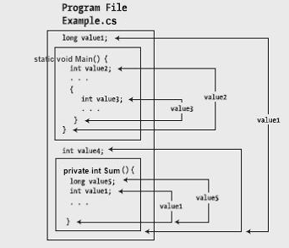
Scope, Lifetime, Span, Purpose

Slide 14
Scope of Variables
Scope – a way of thinking about a variable’s celebrity status
How famous is the variable?
Global (static), member variable, local
Most famous variables can be used anywhere, less famous variables are much more restricted
The scope is often combined with visibility
A variable cannot be visible to an entire namespace (in C#)
May be internal

Slide 15
Visibility of Variables
Variable visibility is explicitly set restriction regarding the access to the variable
public, protected, internal, private
Always try to reduce maximally the variables scope and visibility
This reduces potential coupling
Avoid public fields (exception: readonly / const)
Access all fields through properties / methods

Slide 16

Exceeded Scope – Example
public class Globals
{
public static int state = 0;
}
public class ConsolePrinter
{
public static void PrintSomething()
{
if (Globals.state == 0)
{
Console.WriteLine("Hello.");
}
else
{
Console.WriteLine("Good bye.");
}
}
}

Slide 17
Span of Variables
Variable span
The lines of code (LOC) between variable usages
Average span can be calculated for all usages
Variable span should be kept as low as possible
Define variables at their first usage, not earlier
Initialize variables as late as possible
Try to keep together lines using the same variable
Always define and initialize variables just before their first use!

Slide 18
Calculating the Span of a Variable
One line between the first reference to b and the second
There are no lines between the second reference to b and the third
The average span for b is (1 + 0) / 2 = 0.5
1 a = 1;
2 b = 1;
3 c = 1;
4 b = a + 1;
5 b = b / c;
span = 1
span = 0

Slide 19
Variable Lifetime
Variable lifetime
The number of lines of code (LOC) between the first and the last variable usage in a block
Lifetime should be kept as low as possible
The same rules apply as those for minimizing span:
Define variables at their first usage
Initialize variables just before their first usage
Try to keep together blocks of code using the same variable

Slide 20
Measuring the Lifetime of a Variable
Average lifetime for all variables:
( 4 + 8 + 8 ) / 3 ≈ 7
recordIndex
(line 28 - line 25 + 1) = 4
25 recordIndex = 0;
26 while (recordIndex < recordCount) {
27 ...
28 recordIndex = recordIndex + 1;
...
62 total = 0;
63 done = false;
64 while ( !done ) {
...
69 if ( total > projectedTotal ) {
70 done = true;
total
(line 69 - line 62 + 1) = 8
done
(line 70 - line 63 + 1) = 8

Slide 21
Unnecessarily Large Variable Span and Lifetime
1
2
3
4
5
6
7
8
9
10
11
12
13
14
15
16
17
18
19
int count;
int[] numbers = new int[100];
for (int i = 0; i < numbers.Length; i++)
{
numbers[i] = i;
}
count = 0;
for (int i = 0; i < numbers.Length / 2; i++)
{
numbers[i] = numbers[i] * numbers[i];
}
for (int i = 0; i < numbers.Length; i++)
{
if (numbers[i] % 3 == 0)
{
count++;
}
}
Console.WriteLine(count);
lifetime = 19
span =
(5+8+2)
/ 3 = 5

Slide 22
Reduced Span and Lifetime
1
2
3
4
5
6
7
8
9
10
11
12
13
14
15
16
17
18
int[] numbers = new int[100];
for (int i = 0; i < numbers.Length; i++)
{
numbers[i] = i;
}
for (int i = 0; i < numbers.Length / 2; i++)
{
numbers[i] = numbers[i] * numbers[i];
}
int count = 0;
for (int i = 0; i < numbers.Length; i++)
{
if (numbers[i] % 3 == 0)
{
count++;
}
}
Console.WriteLine(count);
lifetime = 9
span =
(4+2) / 3 = 2

Slide 23
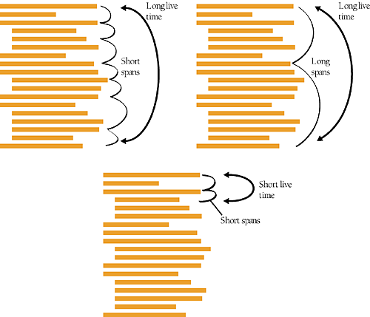
Keep Variable Span and Lifetime Short
Advantages of short time and short span
Gives you an accurate picture of your code
Reduces the chance of initialization errors
Makes your code more readable
The best case

Slide 24
Best Practices
Initialize variables used in a loop immediately before the loop
Don’t assign a value to a variable until just before the value is used
Never follow the old C / Pascal style of declaring variables at the beginning of each method
Begin with the most restricted visibility
Expand the visibility only when necessary
Group related statements together

Slide 25
Group Related Statements – Example
Six variables for just this short fragment
void SummarizeData(…)
{
…
GetOldData(oldData, numOldData);
GetNewData(newData, numNewData);
totalOldData = Sum(oldData, numOldData);
totalNewData = Sum(newData, numNewData);
PrintOldDataSummary(oldData, totalOldData);
PrintNewDataSummary(newData, totalNewData);
SaveOldDataSummary(totalOldData, numOldData);
SaveNewDataSummary(totalNewData, numNewData);
…
}
You have to keep track of oldData, newData,
numOldData, numNewData, totalOldData and totalNewData

Slide 26
Better Grouping– Example
void SummarizeDaily( … )
{
GetOldData(oldData, numOldData);
totalOldData = Sum(oldData, numOldData);
PrintOldDataSummary(oldData, totalOldData);
SaveOldDataSummary(totalOldData, numOldData);
…
GetNewData(newData, numNewData);
totalNewData = Sum(newData, numNewData);
PrintNewDataSummary(newData, totalNewData);
SaveNewDataSummary(totalNewData, numNewData);
…
}
The two blocks are each shorter and individually contain fewer variables

Slide 27

Single Purpose
Variables should have single purpose
Never use a single variable for multiple purposes!
Saving memory is not an excuse
Can you choose a good name for variable that is used for several purposes?
Example: variable used to count students or to keep the average of their grades
Proposed name: studentsCountOrAvgGrade

Slide 28

Using Expressions
Best Practices

Slide 29

Avoid Complex Expressions
Never use complex expressions in the code!
Incorrect example:
Complex expressions are evil because:
Make code hard to read and understand, hard to debug, hard to modify and hard to maintain
What shall we do if we get at this line IndexOutOfRangeException?
for (int i = 0; i < xCoords.Length; i++)
for (int j = 0; j < yCoords.Length; j++)
matrix[i][j] =
matrix[xCoords[FindMax(i) + 1]][yCoords[FindMin(j) - 1]] *
matrix[yCoords[FindMax(j) + 1]][xCoords[FindMin(i) - 1]];
There are 10 potential sources of IndexOutOfRangeException.

Slide 30

Simplifying Complex Expressions
for (int i = 0; i < xCoords.Length; i++)
{
for (int j = 0; j < yCoords.Length; j++)
{
int minXStartIndex = FindMin(i) - 1;
int maxXStartIndex = FindMax(i) + 1;
int minYStartIndex = FindMin(j) - 1;
int maxYStartIndex = FindMax(j) + 1;
int minXcoord = xCoords[minXStartIndex];
int maxXcoord = xCoords[maxXStartIndex];
int minYcoord = yCoords[minYStartIndex];
int maxYcoord = yCoords[maxYStartIndex];
int newValue =
matrix[maxXcoord][minYcoord] *
matrix[maxYcoord][minXcoord];
matrix[i][j] = newValue;
}
}

Slide 31
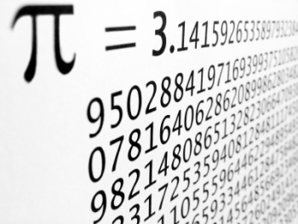
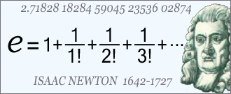
Using Constants
When and How to Use Constants?

Slide 32

Avoid Magic Numbers and Strings
What is a magic number or value?
Magic numbers / values are all literals different than 0, 1, -1, null and "" (empty string)
Avoid using magic numbers / values
They are hard to maintain
In case of change, you need to modify all occurrences of the magic number / constant
Their meaning is not obvious
Example: what does the number 1024 mean?

Slide 33
The Evil Magic Numbers
public class GeometryUtils
{
public static double CalcCircleArea(double radius)
{
double area = 3.14159206 * radius * radius;
return area;
}
public static double CalcCirclePerimeter(double radius)
{
double perimeter = 6.28318412 * radius;
return perimeter;
}
public static double CalcElipseArea(double axis1, double axis2)
{
double area = 3.14159206 * axis1 * axis2;
return area;
}
}

Slide 34
Turning Magic Numbers into Constants
public class GeometryUtils
{
public const double PI = 3.14159206;
public static double CalcCircleArea(double radius)
{
double area = PI * radius * radius;
return area;
}
public static double CalcCirclePerimeter(double radius)
{
double perimeter = 2 * PI * radius;
return perimeter;
}
public static double CalcElipseArea(
double axis1, double axis2)
{
double area = PI * axis1 * axis2;
return area;
}
}

Slide 35
Constants in C#
There are two types of constants in C#
Compile-time constants:
Replaced with their value during compilation
No field stands behind them
Run-time constants:
Special fields initialized in the static constructor
Compiled into the assembly like any other class member
public const double PI = 3.14159206;
public static readonly string ConfigFile = "app.xml";

Slide 36
When to Use Constants?
Constants should be used in the following cases:
When we need to use numbers or other values and their logical meaning and value are not obvious
File names
Mathematical constants
Bounds and ranges
public static readonly string SettingsFileName =
"ApplicationSettings.xml";
public const double E = 2.7182818284;
public const int ReadBufferSize = 5 * 1024 * 1024;

Slide 37
When to Avoid Constants?
Sometime it is better to keep the magic values instead of using a constant
Error messages and exception descriptions
SQL commands for database operations
Titles of GUI elements (labels, buttons, menus, dialogs, etc.)
For internationalization purposes use resources, not constants
Resources are special files embedded in the assembly
Accessible at runtime

Slide 38

Using Variables and Expressions
Exercises in Class

Slide 39

Summary
Assigning Variables
Variable Usage Guidelines
Use variables to show the intent of your code
e. g. when returning from a method
Keep variable span and lifetime short
Expressions Guidelines
Keep expressions simple
Constants
Avoid "magic" values

Slide 40









Using Variables, Data, Expressions and Constants
http://softuni.org/courses/high-quality-code

Slide 41

License
This course (slides, examples, demos, videos, homework, etc.) is licensed under the "Creative Commons Attribution-NonCommercial-ShareAlike 4.0 International" license
Attribution: this work may contain portions from
"Fundamentals of Computer Programming with C#" book by Svetlin Nakov & Co. under CC-BY-SA license
"C# Part I" course by Telerik Academy under CC-BY-NC-SA license

Slide 42






Free Trainings @ Software University
Software University Foundation – softuni.org
Software University – High-Quality Education, Profession and Job for Software Developers
softuni.bg
Software University @ Facebook
facebook.com/SoftwareUniversity
Software University @ YouTube
youtube.com/SoftwareUniversity
Software University Forums – forum.softuni.bg

